Slide 1
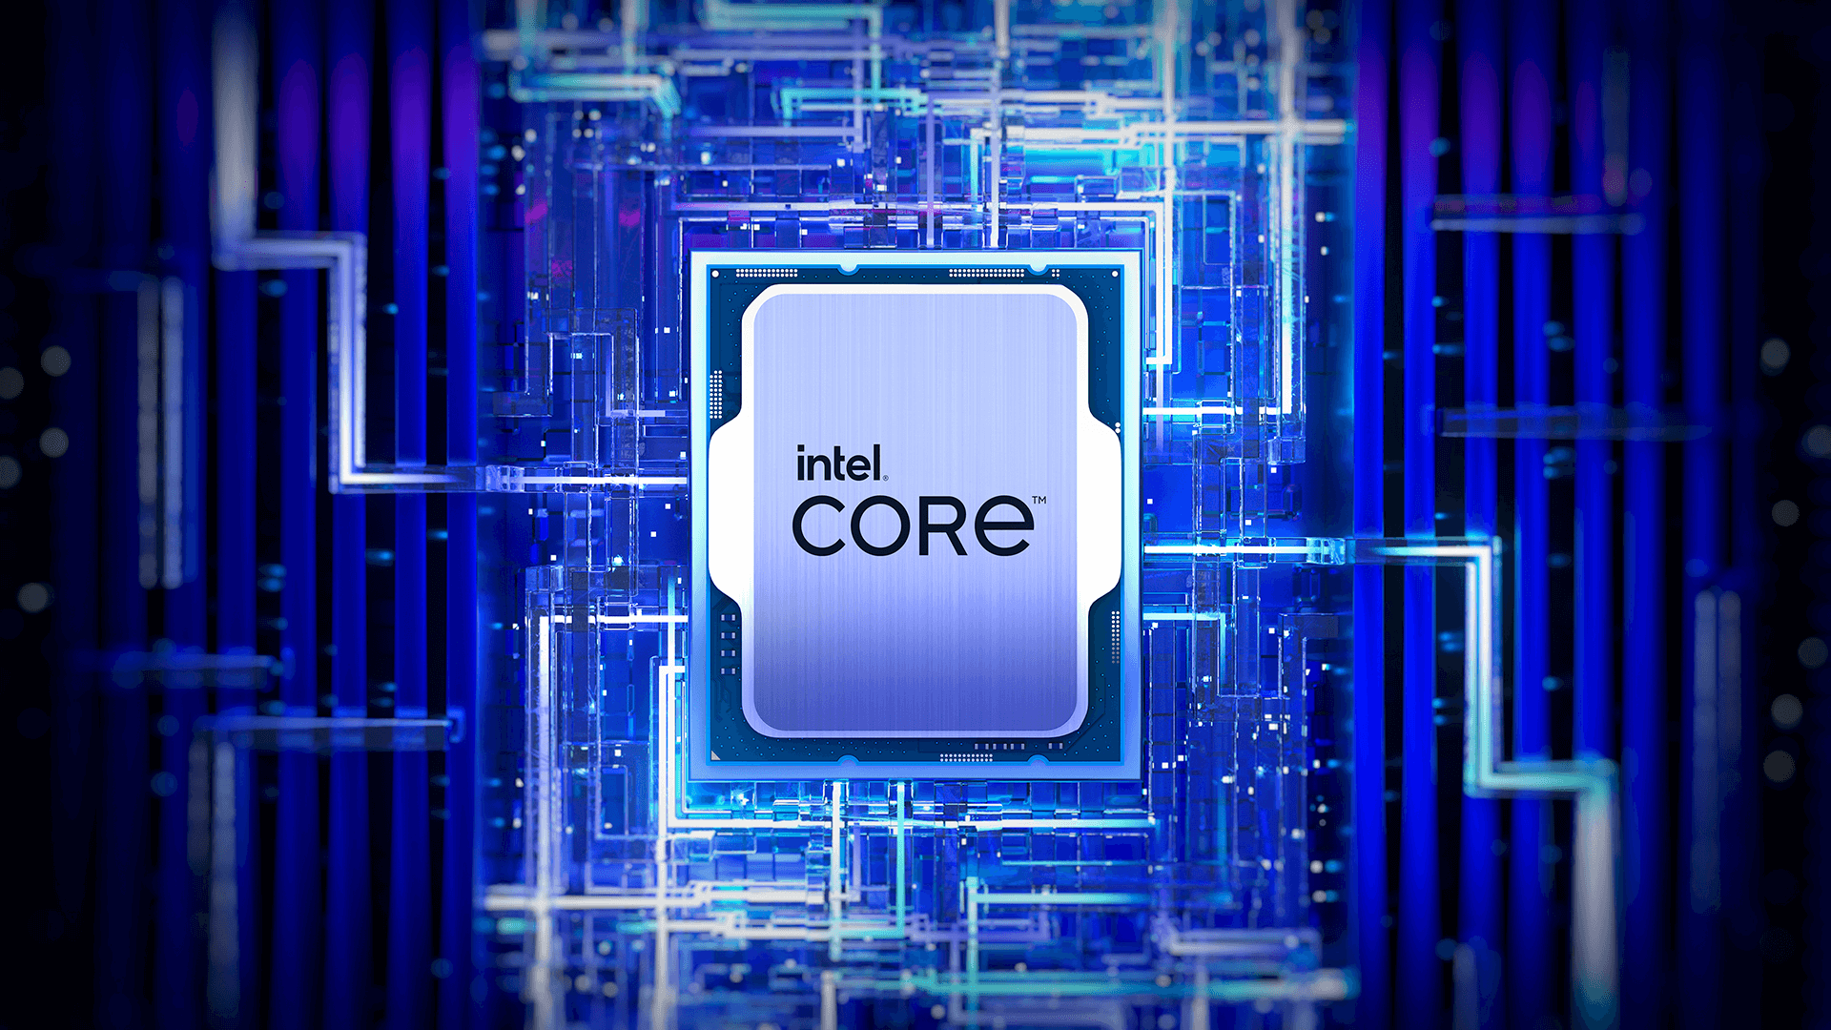
CSA1220-COMPUTER ARCHITECTURE
Superscalar Processing and Modern CPU Architecture
GUIDED BY
RADHIKA S
PRESENTED BY
SANJAY KUMAR P
192565073

Slide 2
INTRODUCTION
What is Superscalar Processing?
A modern CPU architecture designed to execute multiple instructions in a single clock cycle.
Uses multiple execution units such as ALUs and FPUs.
Increases processor performance without increasing clock speed.
Used in Intel Core, AMD Ryzen, Apple M-series, and ARM Cortex processors.

Slide 3
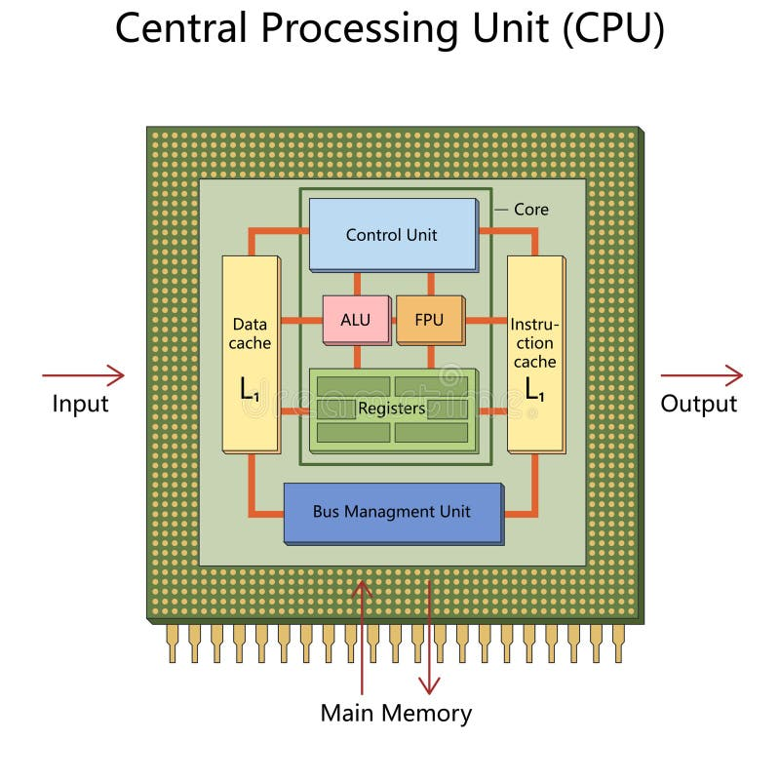
ARCHITECTURE & WORKING
Working of a Superscalar Processor:
Fetch multiple instructions.
Decode instructions.
Analyze instruction dependencies.
Dispatch instructions to different execution units.
Execute instructions simultaneously.
Store the results.
ARCHITECTURE OF CPU

Slide 4
ADVANCED TECHNIQUES
Out-of-Order Execution:
Executes independent instructions before earlier instructions finish.
Reduces waiting time.
Improves CPU efficiency.
Speculative Execution:
Predicts future instructions using branch prediction.
Executes predicted instructions in advance.
Saves execution time when predictions are correct.

Slide 5
HYPER-THREADING
Hyper-Threading is an Intel technology that allows one physical core to function as two logical processors, improving multitasking and CPU utilization.
Benefits
Better multitasking
Increased CPU utilization
Faster parallel processing
Improved overall system performance

Slide 6
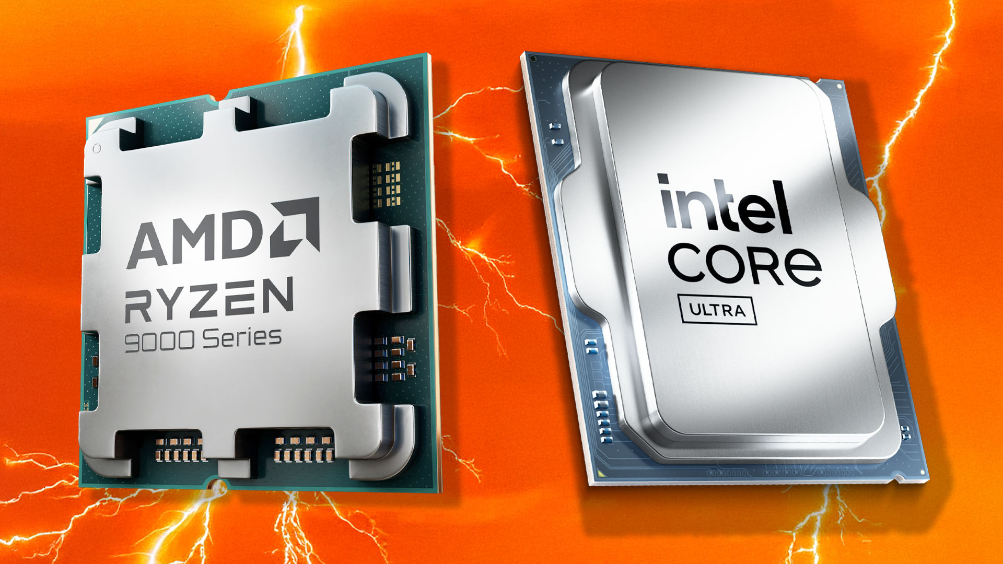
APPLICATIONS
Applications
Superscalar processors are widely used in modern computing applications.
Used In
Artificial Intelligence (AI)
Machine Learning
Gaming Systems
Video Editing
Modern Processors
Intel Core i5 / i7 / i9
AMD Ryzen Series
INTEL AND AMD PROCESSOR

Slide 7
ADVANTAGES & LIMITATIONS
Advantages :
✔ High processing speed
✔ Executes multiple instructions simultaneously
✔ Better multitasking
✔ Efficient CPU utilization
✔ Improved overall performance
Limitations :
✖ Complex processor design
✖ Higher manufacturing cost
✖ Increased power consumption
✖ Security vulnerabilities (Spectre & Meltdown)

Slide 8
CONCLUSION
Superscalar architecture is one of the most important advancements in modern computer architecture.
It improves processor performance by executing multiple instructions in parallel.
Technologies such as Out-of-Order Execution, Speculative Execution, and Hyper-Threading make today's processors faster and more efficient.
Modern CPUs from Intel, AMD, Apple, and ARM all use these techniques to deliver high performance.

Slide 9
THANK YOU

